Slide 1

Credit Risk Analysis & Insights using Power BI
Overview:
This dashboard was designed to help the financial institution why there are so many loan defaults by identifying pattern and highlight trend in loan default behaviour. It is analysing borrower characteristics such as education level, income type, gender, occupation and regional risk. These insights support better decision making and help lender improve credit risk assessment and lending policies.
Tools Used:
Power BI Desktop
DAX (Calculated Columns and Measures
Excel/CSV Data
By:
Ankit Rawat
Data Analyst
ankitrawat.ds@gmail.com
Linkedin

Slide 2
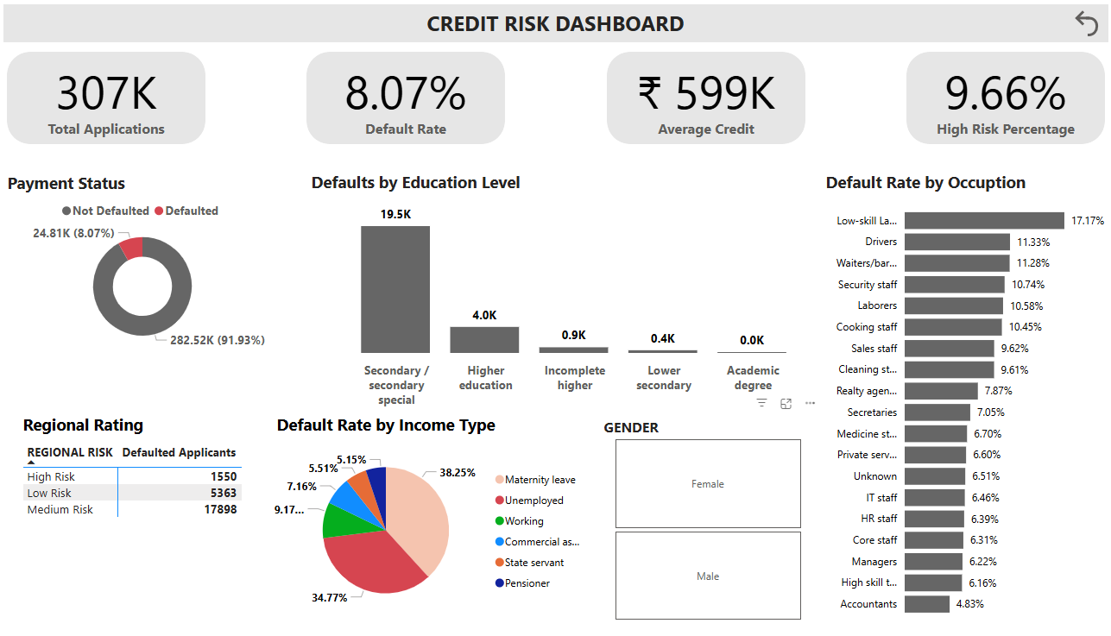

Slide 3
Meaningful Insights
Overall Loan Default Situation-
Out of 307K total loan applications, about 8.07% borrowers defaulted.
Around 91.93% of borrowers repay successfully, which indicates the portfolio is mostly healthy but still contains a significant risk segment.
Education Level Strongly Influences Defaults-
Secondary / Secondary Special Education has the highest number of defaults (~19.5K).Higher education borrowers show much lower defaults (~4K).Very low defaults in incomplete higher and lower secondary education.
Income Type is a Major Risk Indicator-
Unemployed borrowers and borrowers on maternity leave contribute the highest default share (~73.02%)
Borrowers without stable income sources have significantly higher default risk.
The analysis reveals that employment stability, occupation type, and education level are the key drivers of loan defaults. Borrowers with unstable income sources and low-skill occupations demonstrate significantly higher credit risk. These insights enable financial institutions to refine credit scoring models and implement targeted lending strategies to minimize financial losses.

